Slide 1
Data Organization and Retrieval (Organization & Searching)
Subhasis Bhattacharjee
Computer Science & Engineering, IIT Jammu

Slide 2
Problems With the Classical Model
(There are obvious problems with the UI; let’s focus on the problems with the model of IR that it implements)
People don't just search "formal" information sources
Users learn during the search process
They refine their original queries and generate new ones
They might change their preferences for recall and precision

Slide 3
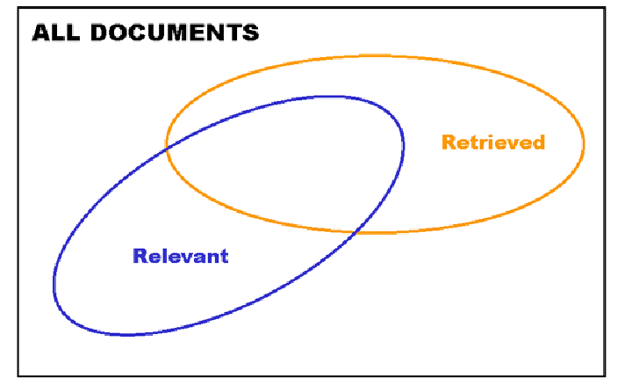
Understanding Recall and Precision

Slide 4
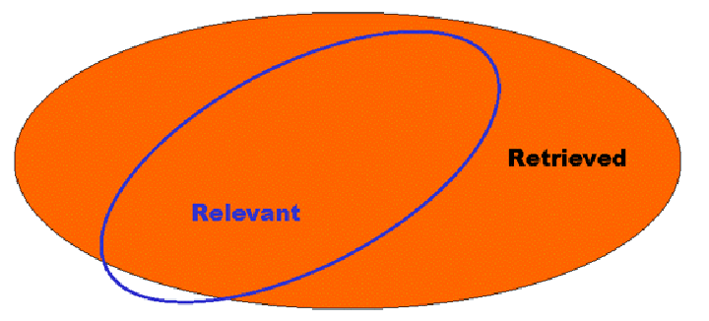
High Recall with Low Precision

Slide 5
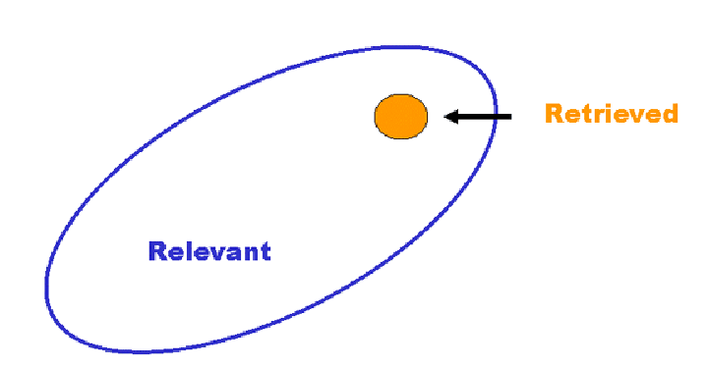
Low Recall with High Precision

Slide 6
Organization Philosophy
To organize is to create capabilities by intentionally imposing order and structure
We select, organize, interact with, and maintain resources
We organize resources as individuals, their association with other individuals
Structures, Methods, and the tradeoffs vary significantly in different domains and contexts

Slide 7
Organization examples in Real Life
Libraries, museums, retail stores, medicine shops
Business information, banking data, scientific data… and other institutional resource collections
Different types of documents – from narrative to transactional – which have characteristic content, structures, and presentations
Personal information and artifacts of all kinds in our kitchens, closets, personal computers, music collections, …
Finally, Apps in your smartphones..

Slide 8
Organizing System
A collection of resources
Intentionally arranged
To enable some set of interactions
Organization & Retrieval works “hand in hand”
What to retrieve ?
How to retrieve ?
From where to retrieve ?

Slide 9
Organizing Principles
Typical arrangements are based on ownership, origin, taxonomic, (usage frequency, correlated usage)
Any resource with a orderable name or identifier can have alphabetic or numeric ordering
Any resource with an associated date (creation, acquisition) can have chronological ordering
Principles should be expressed logically in a way that doesn’t assume an implementation (as much as possible)

Slide 10
Other Organizing [Principles]
Categorization (Creating “equivalence classes” of resources that we treat the same)
Classification (Creating models for assigning resources to existing categories)
Integration (Combining categories)
Segmentation (Discovering categories computationally, assigning resources to them)
Recommendation (Selecting resources according to explicit or implicit preferences)

Slide 11
Organization By Resource Type
Organizing Systems
Collections of Books
(Libraries)
Collections of Art
(Museum)
Collections of Documents
(Archive)
Collections of Data
(Repository)
Collections of Spices (Pantry) …

Slide 12
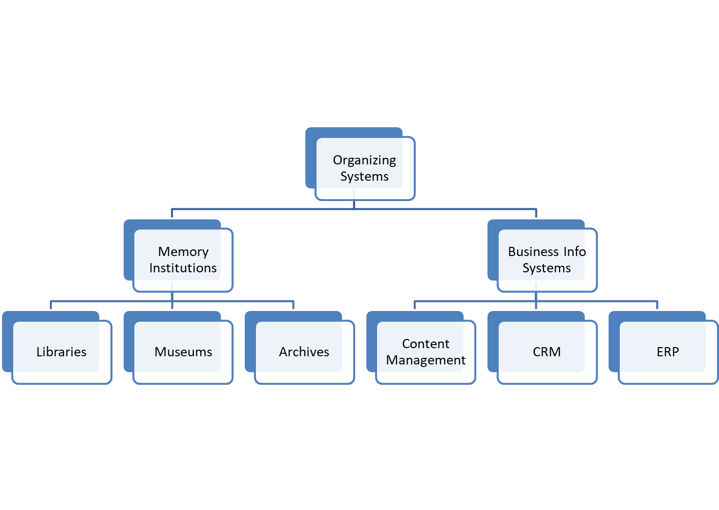
Organization By Purpose

Slide 13
5 Dimensions of an Organizing System
What Is Being Organized?
Data / Information
Why Is It Being Organized?
How Much Is It Being Organized?
When Is It Being Organized?
Who (or What) is Organizing It?
Automated / Computing systems

Slide 14
Why Is It Being Organized?
Bringing like things together, differentiating unlike things
Interactions – can include access, reuse, copying, transforming, translating, comparing, combining, visualizing, recommending
We wouldn’t organize anything that we do not expect to access again

Slide 15
How Much Is It Being Organized?
Everything may not be organizable, because not everything is equally describable
May not be expressible / categorized within limited vocabulary
Are you organizing the resources you have, or do you need to create an organizing system that can apply to resources that you have not yet collected?
The scope and size of a collection shapes how much it needs to be organized

Slide 16
When Is It Being Organized?
When the resource is created
When it is added to some collection
Never
All the time - continuous or incremental

Slide 17
Organization Systems - Components
Information Architecture
Search
Maintenance
Update

Slide 18
Search in Data Organization & Retrieval
Not an isolated interaction
Continuous process – multiple searches
Multiple category of searching
Variety of outputs
Answers to specific questions
“about info”
Update not a single type of interaction

Slide 19
Search Models
Classical model
Definitive answer type / exact search
Iterative models
system matches the descriptive features in the query against the features that describe the "documents“
Documents are retrieved when the degree of the match exceeds some measure of similarity
Accidentally / luckily – exact match
Information foraging

Slide 20
Information Foraging
A theory about the search process called INFORMATION FORAGING was proposed by Peter Pirolli and Stuart Card (2007 book)
Uses concepts of foraging theory from evolutionary biology to analyze the cost structure of search and
How do predators decide which prey to hunt? == How does an "inforvore" choose which information resources to pursue?
Animals adapt their search strategies == Inforvores also adapt search tactics, and modify their own information environments and information organization to make their searches more productive select the highest value strategy

Slide 21
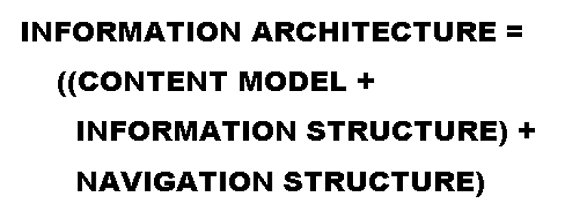
Defining Information Architecture

Slide 22
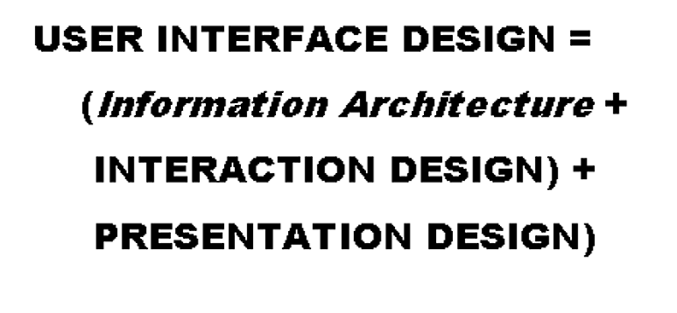
Defining via Interface

Slide 23
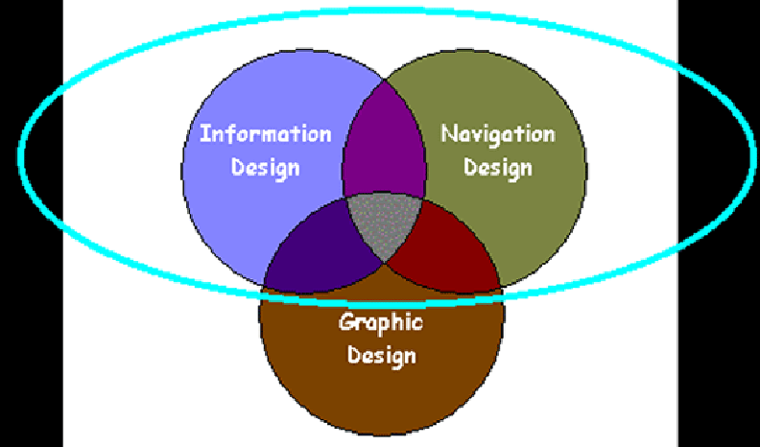
A More Typical Definition of IA

